Slide 1







MARKETING
PLAN
PRESENTATION
SHAWN SHI
Confidential

Slide 2
AGENDA
1
INTRODUCTION
2
DATA SET INTRODUCTION
3
CLUSTERING MODEL
4
PREDICTION MODEL
Confidential

Slide 3
Predicting
Online
vs.
Offline Shopping
Confidential

Slide 4
Why This Matters
•Online shoppers and in-store shoppers respond to different marketing channels
•If we can predict who is likely to shop online, we can allocate ad budget more efficiently
Goal: match the right customer segment with the right channel

Slide 5
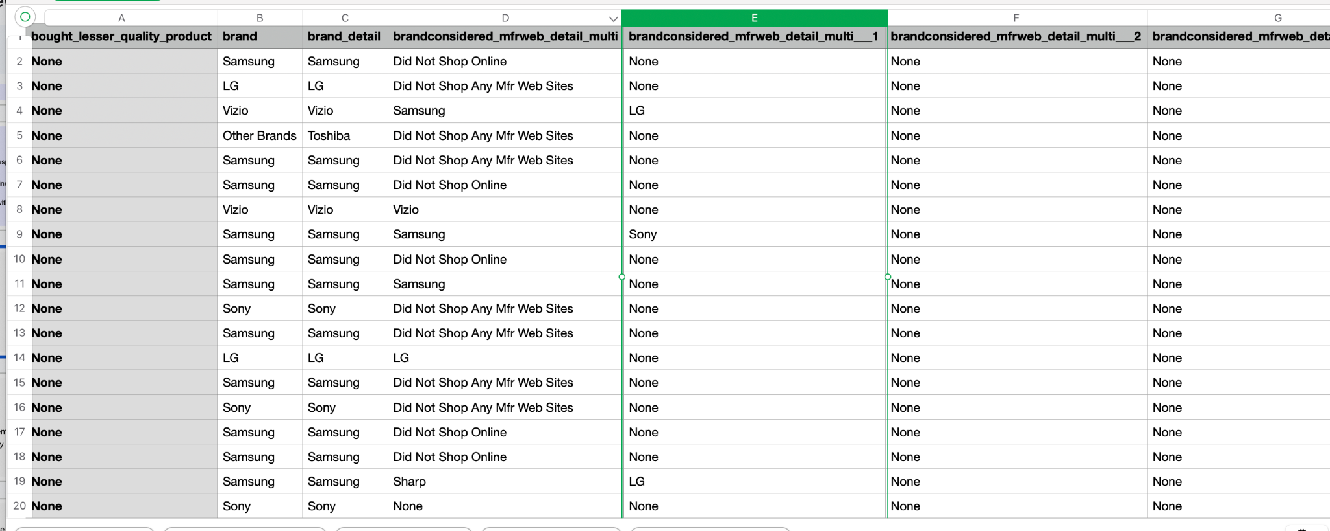
Dataset
https://app.deweydata.io/data/openbrand/consumer-insights-survey-data/consumer-electronics
Confidential

Slide 6
Prediction task
•Target: SHOP_ONLINE (1 = online shopper, 0 = offline shopper)
•This is a binary classification problem
•We evaluate models using Accuracy and AUC
Confidential

Slide 7
Approach Overview
•Step 1: Cluster consumers to reduce heterogeneity (different types of shoppers)
•Step 2: Train separate prediction models within each cluster
•Why: each segment can have different drivers for online shopping
Confidential

Slide 8
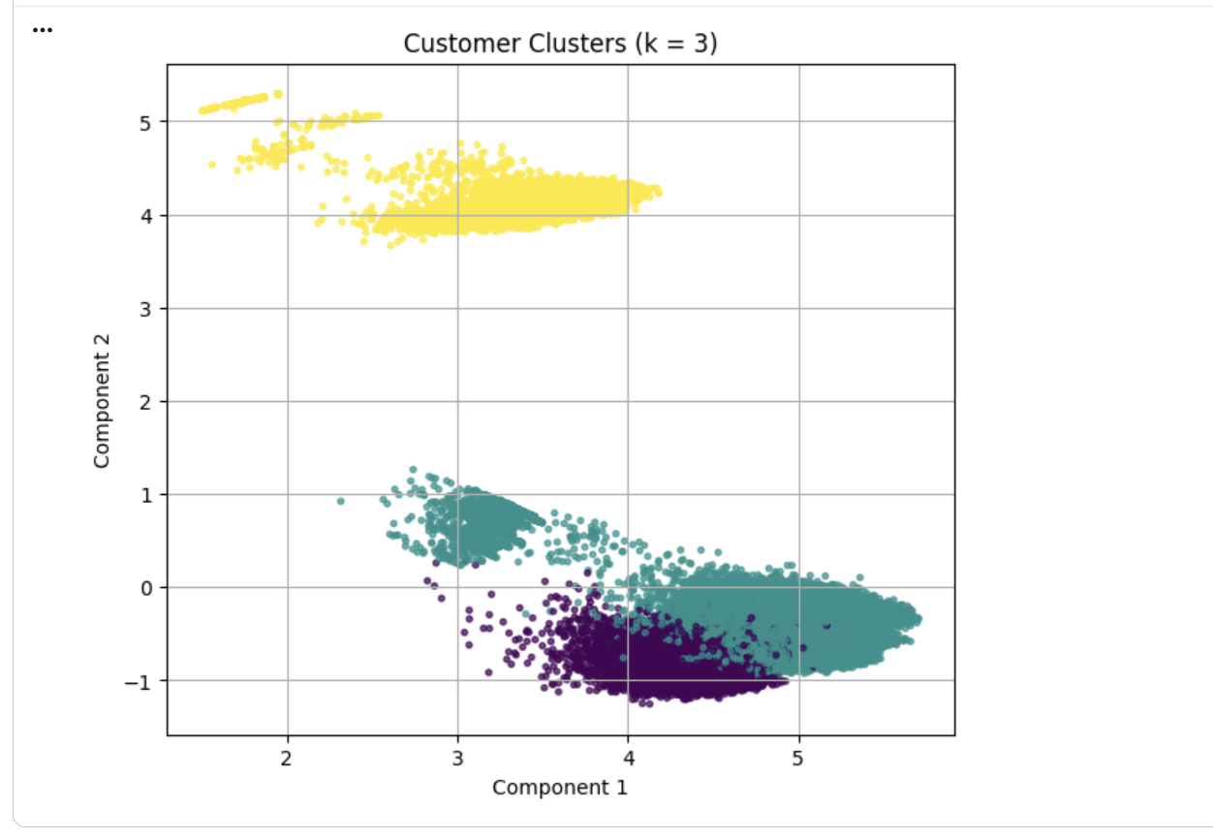
Clustering Visualization
Confidential

Slide 9
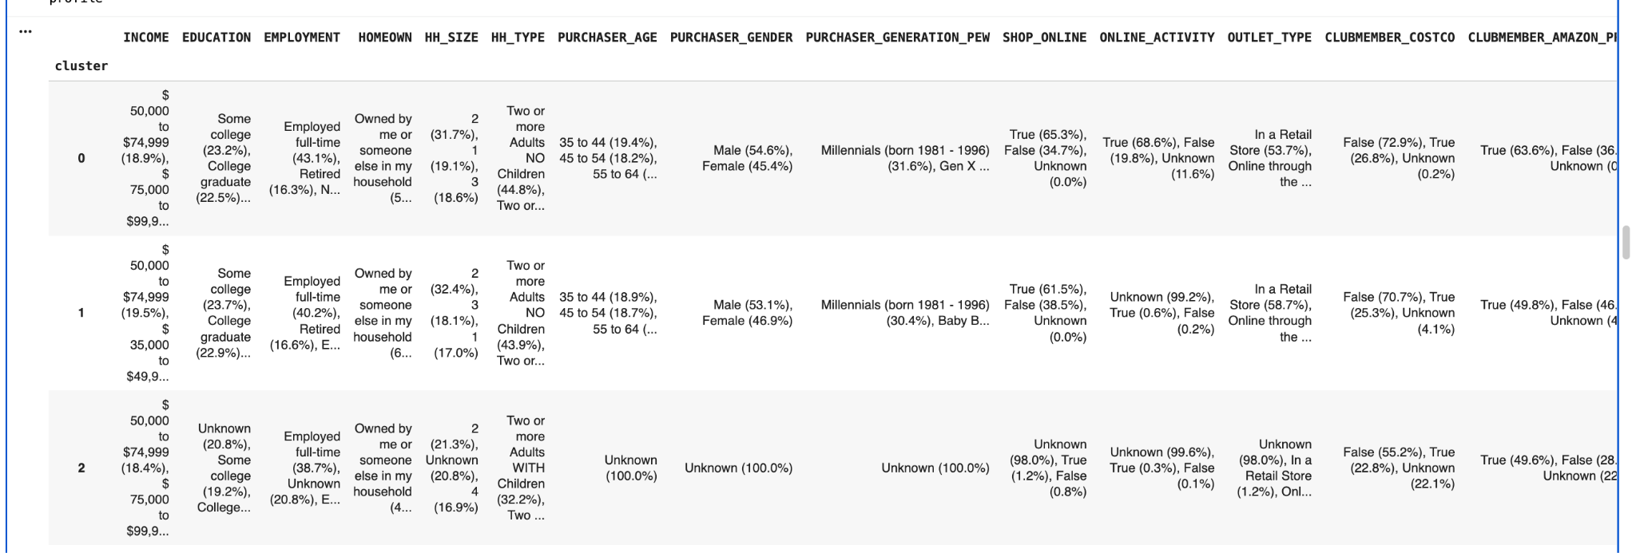
Clustering
Confidential

Slide 10
Clustering 0
•Higher online shopping rate: SHOP_ONLINE True ≈ 65%
•Online activity signal is strong: ONLINE_ACTIVITY True ≈ 69% (some Unknown)
•Typical working-age, mid-income households; mostly urban/metro
•Interpretation: online behavior is explainable and predictable from observed signals
Confidential

Slide 11
Clustering 1
•Higher online shopping rate: SHOP_ONLINE True ≈ 65%
•Online activity signal is strong: ONLINE_ACTIVITY True ≈ 69% (some Unknown)
•Typical working-age, mid-income households; mostly urban/metro
•Interpretation: online behavior is explainable and predictable from observed signals
Confidential

Slide 12
Clustering 2
•Large proportion of missing or unknown demographic and behavior variables
•Weaker and less consistent signals
•Interpretation and targeting require more caution
Confidential

Slide 13
Step2: What We Did For Each Cluster
•Trained prediction models separately within each cluster
•Used Logistic Regression as a baseline model
•Applied tree-based models to capture more complex behavior patterns

Slide 14
Model Result
•Prediction models perform well in identifying online vs. offline shoppers
•Tree-based models outperform the linear baseline
•Results suggest shopping channel choice is driven by multiple interacting factors

Slide 15
Business Value 1
•Clustering turns a large customer base into manageable segments
•Each cluster forms a clear customer profile with distinct behaviors
•Helps marketers understand who their customers are and how they shop

Slide 16
Business Value 2
•Prediction models translate customer profiles into channel decisions
•Cluster 0: prioritize online ads, email, and retargeting
•Other clusters may benefit more from in-store or combined campaigns

Slide 17
Example: Applying Insights to Marketing
•Digital-first customers: online ads, email campaigns, Black Friday promotions
•Store-first customers: in-store promotions supported by online awareness
•Platform choice matters: Instagram vs. email vs. in-store events

Slide 18
Conclusion
•Clustering helps companies understand different types of customers
•Prediction models help decide where and how to market to them
•Together, they support more efficient and strategic marketing decisions

Slide 19
THANK YOU!

